Slide 1
CS 555 Distributed Systems – Fall 2025
Chris Cowart, Nate Mattie

Slide 2

Problem Characterization
Routing requires near-real time KPIs per zone/tract that are influenced by outside events
Weather
Events
Data is
Spatial
out-of-order
Multiple sources/formats

Slide 3
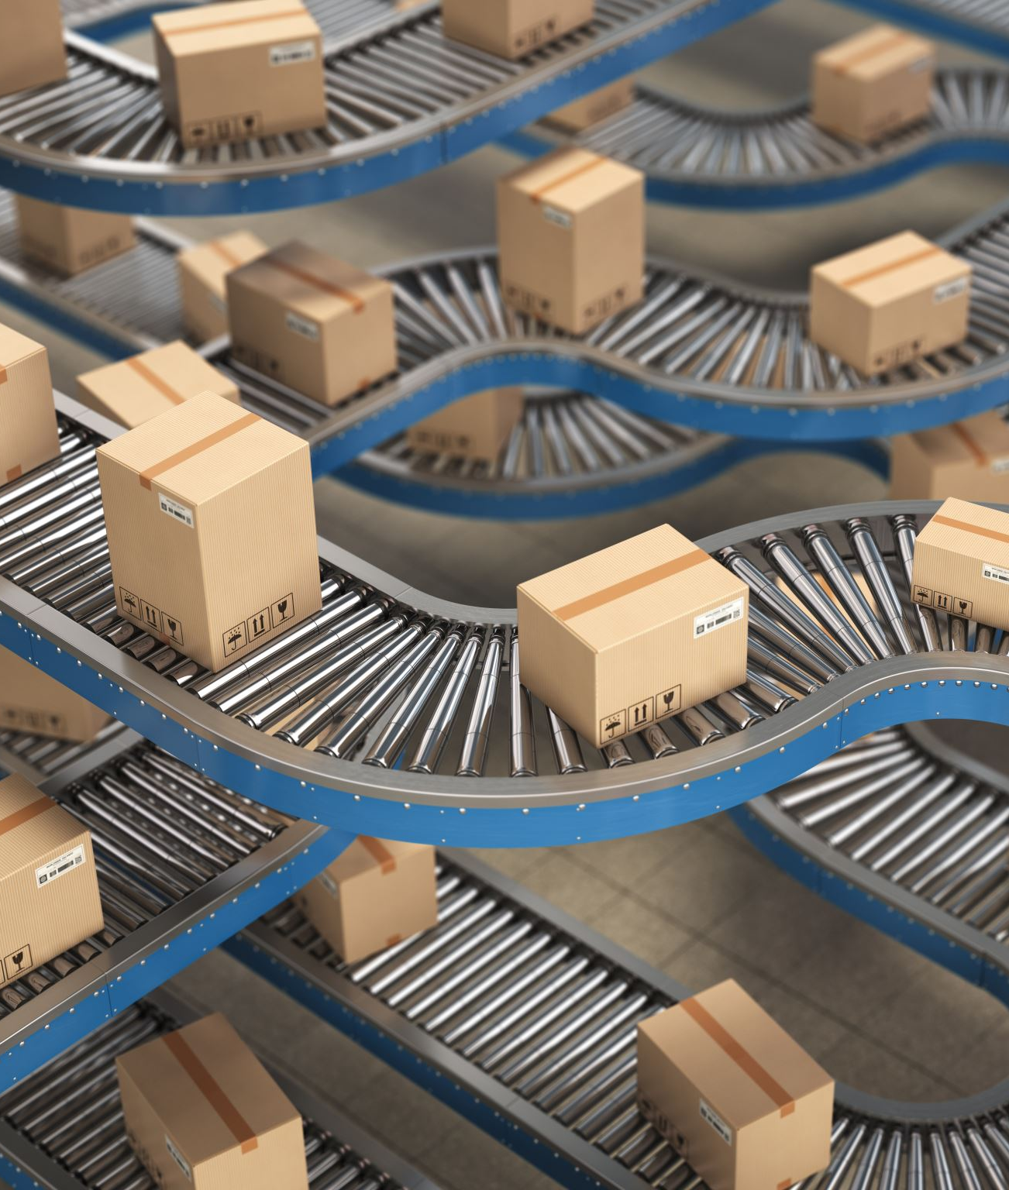
Why This Matters
Without consistency and timeliness people lose trust
Can not distribute people load based on needs (think uber surge pricing)
Focus on
Delivery (speed/accuracy)
Robustness

Slide 4

Proposed Solution
Pipeline
Producers publish and send information
Distributed Ledge (Kafka)
Enrichment (Spark)
Query/Storage (Parquet/Iceberg)

Slide 5
Evaluation
Throughput vs node count
Latency (ingest -> process -> sink -> commit)
Failure recovery: MTTR
Stability of input/output rates; Queue depth
Duplication and correctness of of dupes/omissions

